Slide 1


Effective Unit Testing
Wayne Schroder
Sample code/demos available at:
https://github.com/wschroder/UnitTestingDemo.GitHub
Notes:
If you’re watching this, I already know a few things about you:
Since you work at AgileThought, odds are pretty good that you already do unit testing and know the basics.
As with many developers, you’ve probably felt some measure of frustration with unit tests
You care about your art, and want to know best practices

Slide 2

30 years development
Live in Atlanta with my wife, Gana.
5 kids (blended family), 4 5 grandkids
Reading, learning, fitness and camping
Code for Atlanta
Software design & architecture, Cloud-native development
x

Slide 3


Slide 4

Agenda
Arrange / Act / Assert
Isolation
Code Coverage
TDD Cycle: Red-Green-Refactor
Behavior Focused Testing
Add structure with “TestHelper” Pattern
Pitfalls (Testing the wrong things)
Configuration
Dependencies
Environment
Implementation

Slide 5

Smart vs. Professional
“Programmers are pretty smart people. Smart people sometimes like to show off their smarts by demonstrating mental juggling abilities. … [The] difference between a smart programmer and a professional programmer is that the professional programmer understands that clarity is king. Professionals use their powers for good and write code that others can understand.”
Robert Martin, Clean Code

Slide 6


“Clean” Tests
Short, sweet & visible
Run fast
Isolate your test subject
Focus on behaviors / responsibilities
Notes:
To make unit tests that are maintainable, they should have the following qualities:
Short –
* Same guidance as for methods. One good suggestion is that unit tests should fit on a laptop screen. * When longer, people have to mentally keep track of what’s going on, making it harder to maintain & more error prone.
Sweet – Readable & structured, thus easily understood.
Visible – You can tell what is happening by a quick scan. No hidden surprises.
Fast – Tests should run fast. If there is some code they call that takes over 1 second to run, consider refactoring.
Isolate your test subject. Each test should focus on testing only one operation from one class, and one scenario of that operation.
Focus on behaviors & responsibilities. If your test breaks, it should be because the code was changed to no longer uphold its responsibility. It should not break just because someone tweaked the implementation of the method.

Slide 7
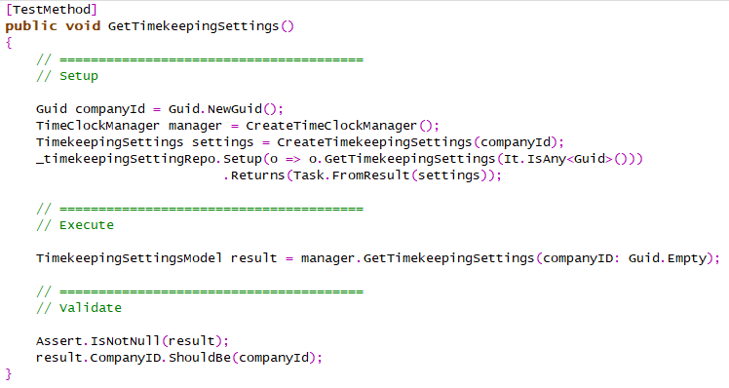
Arrange
Act
Assert
Notes:
Structure.
Short
Sweet - Readable & structured
Visible
Isolates the test subject.
Focuses on testing one scenario for one operation
Focus on behaviors & responsibilities.

Slide 8

Test Scope
SUT
Scenario A
Operation 1
Scenario B
private method 1
Scenario C
private method 2
Scenario A
Operation 2
Scenario B
private method 3
private method 4
Notes:
Guidelines
SUT (“Subject Under Test”) is the test class
One test class per SUT and one SUT per test class
Identify the public operations (public methods)
Identify scenarios
Happy path
Missing/bad parameters
Invalid situations
Problem responses from dependent objects
One test per (operation x scenario)
See RetailStoreTests.cs

Slide 9

Test “Mocks”
Isolation from other code
Setting state / preconditions
Verifying calls made
Callbacks
More control over mock behavior
Caching of run-time parameters
Notes:
Isolation from other code
Dependency Injection
See ShoppingCart constructor
Setting state / preconditions
Verifying calls made / Not made
Callbacks
More control over mock behavior at runtime
Caching of parameters for later evaluation

Slide 10

Focus on Responsibilities
Brittle Tests – Tests based on unimportant implementation details
Expected responses & changes to environment

Slide 11

Pitfalls
Complex test setup
Short-circuit tests
Testing the Wrong Things:
Configuration
Dependencies
Environment
Implementation

Slide 12
Test Driven Development (TDD)
Start
Test
Code
Test
Refactor
Finish
Notes:
Trains you to focus on class/method responsibility

Slide 13
“TestHelper” Pattern
Goal: Make complex tests easier to understand & maintain
Add structure by splitting out a test-helper class
Home for more complex test logic
Makes your tests clean & simple, focused on high level test logic
Separates out clutter like object creation, test setup, test verification steps
For complex setups, extend with Builder Pattern

Slide 14
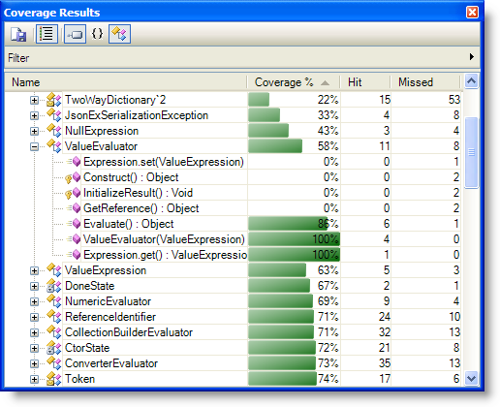
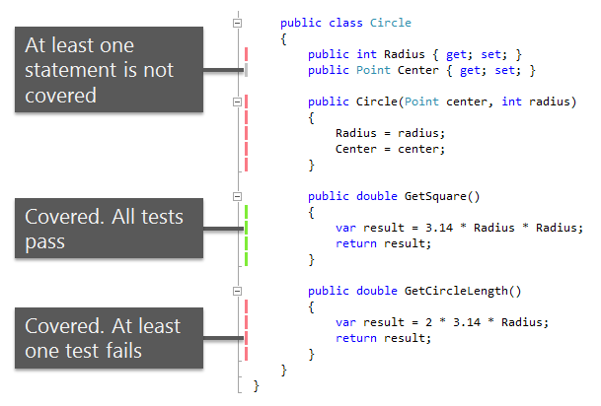
Code Coverage

Slide 15

Broken Tests
“All Green” as a Safety Net
Options when tests broken:
Fix broken tests now (Best option)
Mark broken tests as "Ignore"
Leave them broken (Worst option)

Slide 16
Integration Tests
Web service / API
Database
Keep in separate projects
Manual Testing
Integration Testing
Unit Testing
more integration
slower
more isolation
faster
https://martinfowler.com/articles/practical-test-pyramid.html

Slide 17

Database Integration Tests
Needed when logic stored in DB
Isolate!
Version synchronization
Cleanup strategy (PRE or POST test)
Use fixed value for common attribute
Keep list of references to created data
Risks
Assumptions about data
Assumptions about schema version
Concurrent testing against shared DB

Slide 18
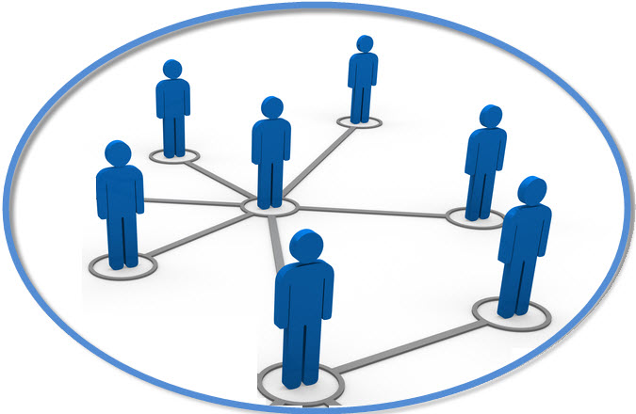
Web Integration Tests
Requires explicit setup
More complexity = More brittle
Greater risk of data dependency
This Photo by Unknown Author is licensed under CC BY-NC

Slide 19
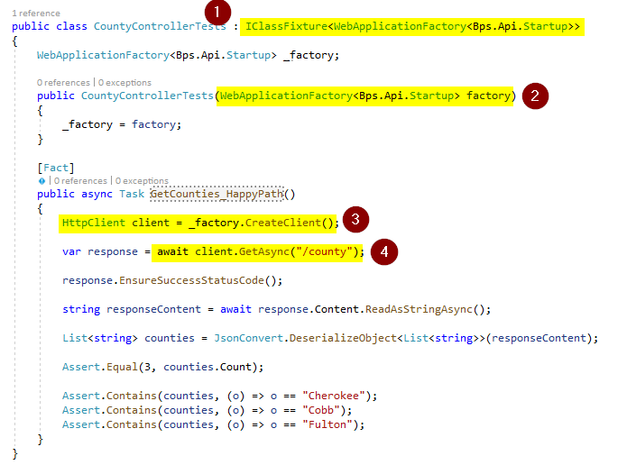
API Controller Tests (self hosted)
See: Microsoft.AspNetCore.Mvc.Testing

Slide 20

Main Points to Remember
Keep tests short, sweet & visible.
Focus on testing behaviors / responsibilities
Isolate your test subject.
Keep tests fast.
Use structure to keep tests easy to read/maintain.
“All Green” policy / Protect the safety net
Keep Unit Tests and Integration Tests separate

